Slide 1
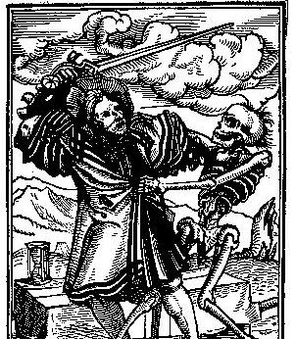

Morality Plays and Everyman
In collaboration with Beyza Kayış, MA Student
Assist. Prof. Dr. Pelin GÖLCÜK MİRZA

Slide 2
MIRACLE PLAYS
HISTORICAL CONTEXT OF LITURGICAL DRAMA
They reanact the lives of saints and representation of Bible stories in churches.
The main aim was to teach Christianity and spread the Christian doctrines.
**Liturgical drama was introduced to Britain after the Norman Conquest.

Slide 3

HISTORICAL CONTEXT OF LITURGICAL DRAMA
Corpus Christi Play (Mystery Plays) concerns the remembrance of the life of Jesus Christ.
They are dramatizations of both the Old and New Testament miracles
Another popular topic was Christ and his crucifixion and resurrection.
In the beginning of the popularity of Mystery plays, the parts in the performance were played by clergymen and other members of the church.
During their peak, Mystery plays were moved out of the church and performed on wagons (pageants, see the next slide) and moved about the different towns
. Due to the separation from the church the plays tended to have more of sarcastic tone to them and sometimes even went as far as mocking priests and monks, the people who had a big part in the creation of the plays.
A huge aspect of Mystery plays was that they neglected to utilize the three unities; place, time, and action.
Also they did not limit their performances, they used technologies, such as trap doors and mechanisms to create the illusion of flying, to get the realest effect and please the audience.

Slide 4
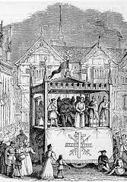
With an ever growing audience to please, the town-guilds found that a perfect opportunity to demonstrate their works with the introduction of the Corpus Christi* festival, in 1311, that takes place 57 days after Easter.
The performances were grouped together and consisted of plays such as, Noah and the Flood, and The Creation of the World and the Fall of Adam. From these small groups came the four most prominent collections of mystery plays, the York cycle with 48 pageants, the Towneley plays with 32 pageants, the Chester cycle with 24 pageants, and the Wakefield (N-town) plays with 42 pageants.
Mystery does not refer to the contemporary meaning of unknown but was derived from the Latin word ministerium, meaning an association of clergy from different religious groups. This was the term used to describe the guilds which performed these plays, which is why is was used to name to describe the actual plays being performed. By the time of the end of the fifteenth century and the beginning of the Reformation, in England, the Mystery plays started to die down and were replaced in popularity by Morality plays.
https://www.youtube.com/watch?v=mIaOv1Fpl40

Slide 5
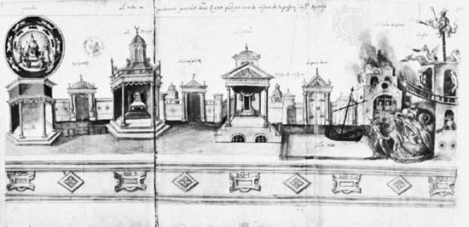

Slide 6
Morality Plays
Morality plays explore what it means to be human as any accepted shared “morality.”
«for humankind is the kind of creature who forgets who he is and who therefore needs reminders» (Sarah Beckwith 90)
They bridge between liturgical and secular drama
Allegorical dramas that teach the moral values and abstract ideas through the use of personification
The most common and famous play is Everyman, an English version of the Dutch Play about the inevitability of death

Slide 7

EVERYMAN
MOMENTO MORI! REMEMBER THAT YOU WILL DIE!

Slide 8
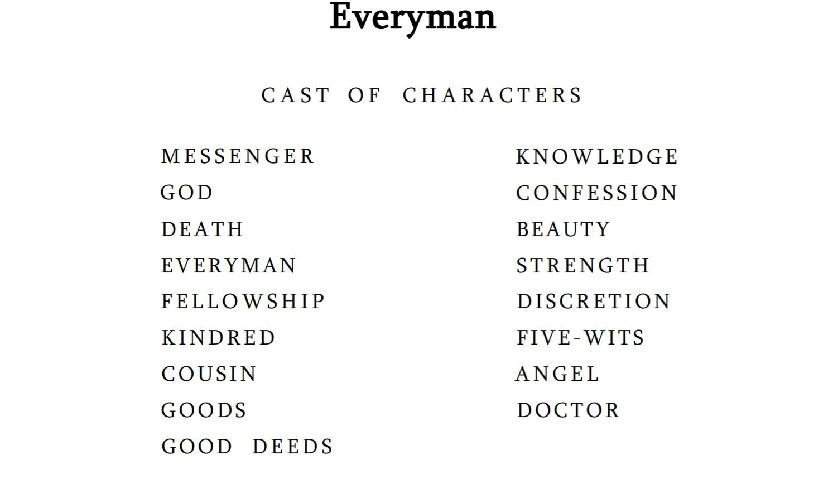

Slide 9
God summons to Everyman
GOD: I perceive here in my majesty,
How that all the creatures be to me unkind,
Living without dread in worldly prosperity:
Of ghostly sight the people be so blind,
Drowned in sin, they know me not for their God;
In worldly riches is all their mind,
They fear not my rightwiseness, the sharp rod;
My law that I shewed, when I for them died,
They forget clean, and shedding of my blood red;
I hanged between two, it cannot be denied;
To get them life I suffered to be dead;
I healed their feet; with thorns hurt was my head:
I could do no more than I did truly,
And now I see the people do clean forsake me.
They use the seven deadly sins damnable;
As pride, covetise, wrath, and lechery,
GOD: Go thou to Everyman,
And show him in my name
A pilgrimage he must on him take,
Which he in no wise may escape;
And that he bring with him a sure reckoning
Without delay or any tarrying.
All human are in sin. They are not aware of God and his punishment. They antagonise God by ignoring the sacrifice he has made for their sake. All people doing seven deadly sins. They are in wordly pleasures. They live in prosperity without fearing God’s warth. Then God calls Everyman on behalf of al humanity. He must go on a journey.

Slide 10
SEVEN DEADLY SINS
Pride
Envy
Wrath
Sloth
Greed
Gluttony
Lust

Slide 11
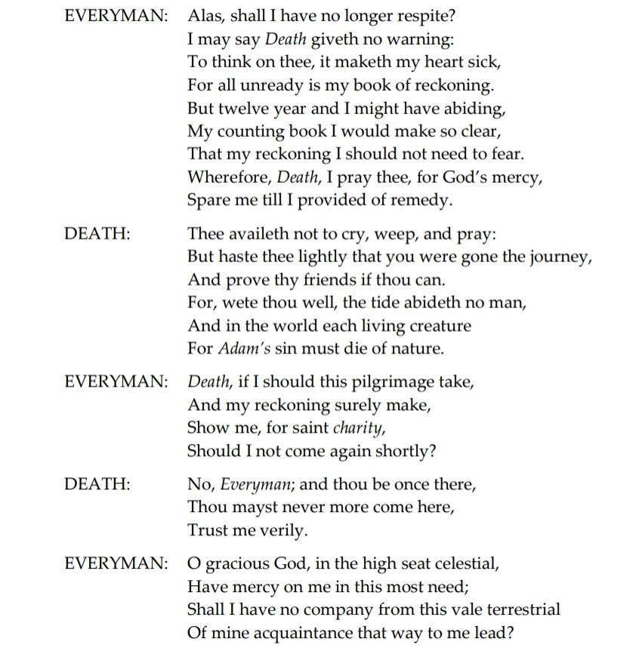
Death delivers the message to the Everyman
DEATH: On thee thou must take a long journey:
Therefore thy book of count with thee thou bring;
For turn again thou can not by no way,
And look thou be sure of thy reckoning:
For before God thou shalt answer, and show
Thy many bad deeds and good but few;
How thou hast spent thy life, and in what wise,
Before the chief lord of paradise.
Have ado that we were in that way,
For, wete thou well, thou shalt make none attournay

Slide 12
CONT’D
Death as a messenger from God, tasked with reminding Everyman of his obligation to account for his life before the Creator. Shocked by Death's sudden summons, Everyman struggles to understand his purpose and expresses unpreparedness for divine judgment.Death explains that Everyman must present his “track record” of good and bad deeds directly to God. There is no advocate or defense, and material wealth and status hold no value. Everyman pleads for more time, offering bribes, but Death rejects all attempts to delay the process, emphasizing the inevitability of judgment and the futility of worldly attachments.Realizing his mistakes too late, Everyman regrets his careless life and wishes he had prepared for this reckoning earlier. He seeks companions for support on his spiritual journey, but Death warns that only true virtues and good deeds will accompany him. Everyman’s desperation leads to a personal catharsis as he reflects on his ignorance of spiritual values, the fear of death, and the transient nature of worldly pursuits. In the end, Everyman resolves to seek guidance and prepare for his final encounter with God.

Slide 13
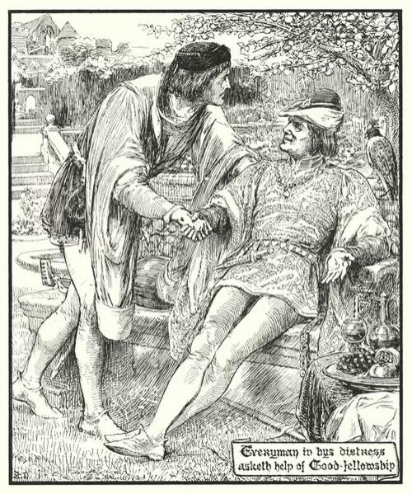

Slide 14
EVERYMAN MEETS FELLOWSHIP
FELLOWSHIP: Now, by God that all hath brought,
If Death were the messenger,
For no man that is living to-day
I will not go that loath journey-
Not for the father that begat me!
EVERYMAN: Ye promised other wise, pardie.
FELLOWSHIP: I wot well I say so truly;
And yet if thou wilt eat, and drink, and make good cheer, or haunt to women, the lusty companion,
I would not forsake you, while the day is clear,
Trust me verily!
EVERYMAN: Yea, thereto ye would be ready;
To go to mirth, solace, and play,
Your mind will sooner apply
Than to bear me company in my long journey.
FELLOWSHIP: Now, in good faith, I will not that way.
But and thou wilt murder, or any man kill, In that I will help thee with a good will!
FELLOWSHIP: And so ye shall evermore;
For, in faith, and thou go to Hell
I will not forsake thee by the way!
EVERYMAN: I shall show you how it is;
Commanded I am to go on a journey,
A long way, hard and dangerous,
And give a strait count without delay
Before the high judge Adonai*. *God
Wherefore I pray you bear me company, As ye have promised, in this journey

Slide 15
CONT’D...
Everyman, troubled by his situation, seeks help from Fellowship, who initially promises unwavering support and even offers to die for him. However, when Everyman reveals that he must journey to meet God and account for his life, Fellowship becomes frightened and refuses to join him. Fellowship admits he is only loyal in times of enjoyment and rejects Everyman’s pleas for support, even in acts of charity. Despite Everyman’s reminders of their shared good times, Fellowship abandons him, leaving Everyman disillusioned and in despair. Realizing the superficiality of Fellowship’s commitment, Everyman turns to Kindred for help.

Slide 16
EVERYMAN MEETS COUSIN AND KINDRED
EVERYMAN: Of all my works I must show
How I have lived and my days spent;
Also of ill deeds, that I have used
In my time, sith life was me lent;
And of all virtues that I have refused.
Therefore I pray you thither with me,
To help to make account, for saint charity.
COUSIN: What, to go thither? Is that the matter?
Nay, Everyman, I had liefer fast bread and water
All this five year and more.
KINDRED: Ah, sir; what, ye be a merry man!
Take good heart to you, and make no moan.
But as one thing I warn you, by Saint Anne,
As for me, ye shall go alone.
EVERYMAN: My Cousin, will you not with me go.
COUSIN: No by our Lady; I have the cramp in my toe.
Trust not to me, for, so God me speed,
I will deceive you in your most need.
KINDRED: It availeth not us to tice.
Ye shall have my maid with all my heart;
She loveth to go to feasts, there to be nice,
And to dance, and abroad to start:
I will give her leave to help you in that journey,

Slide 17
CONT’D...
Everyman seeks the help of his relatives, Kindred and Cousin, after receiving a summons from God through Death to account for his life’s deeds. Initially, both Kindred and Cousin express their willingness to support him, claiming they are ready to face any crisis in honor of kinship. Encouraged by their assurances, Everyman explains his fear of failing to present an account of his sins, virtues, and actions before God.
However, when Everyman requests their companionship on this journey, Cousin suggests he endure the journey alone by living on bread and water, refusing to join him. Kindred mockingly laughs at Everyman and excuses himself by claiming he has a cramp in his toe. Both eventually abandon him, despite their earlier promises, with Cousin pretending his own account is not prepared.
Everyman feels betrayed and laments the insincerity of Kindred and Cousin, realizing their promises were hollow. Left helpless, he recalls his reliance on worldly possessions and turns to Goods for support.

Slide 18
EVERYMAN MEETS GOODS
EVERYMAN: It is another disease that grieveth me;
In this world it is not, I tell thee so.
I am sent for another way to go,
To give a straight account general
Before the highest Jupiter of all;
And all my life I have had joy and pleasure in thee.
Therefore I pray thee go with me,
For, peradventure, thou mayst before God Almighty
My reckoning help to clean and purify;
For it is said ever among,
That money maketh all right that is wrong.
GOODS: Nay, Everyman, I sing another song,
I follow no man in such voyages;
For and I went with thee
Thou shouldst fare much the worse for me;
For because on me thou did set thy hand,
Thy reckoning I have made blotted and blind,
That thine account thou cannot make truly;
And that hast thou for the love of me.
EVERYMAN: That would grieve me full sore,
When I should come to that fearful answer.
Up, let us go thither together.
GOODS: Nay, not so, I am, to brittle, I may not endure;
I will follow no man one foot, be ye sure.
EVERYMAN: Alas, I have thee loved, and had great pleasure
All my life-days on good and treasure.
GOODS: That is to thy damnation without lesing,
For my love is contrary to the love everlasting.
But if thou had loved moderately during,
As, to the poor give part of me,
Then shouldst thou not in this dolour be,
Nor in this great sorrow care.

Slide 19
CONT’D...
Everyman turns to Goods, his worldly wealth, for help in his spiritual crisis. Goods admits he is inanimate and incapable of assisting beyond worldly matters. Everyman asks Goods to help him cleanse his judgment and accompany him on his journey to God, but Goods refuses, warning that his influence has already corrupted Everyman’s account and would further harm his prospects. Goods highlights Everyman’s selfish love for wealth, pointing out that wealth is fleeting, cannot accompany anyone after death, and often leads people to destruction.
Everyman realizes his folly in relying on wealth for salvation and laments how Goods deceived him throughout his life. Goods reveals his true purpose: to trap people in worldly desires and prevent them from seeking God’s forgiveness. Goods leaves to deceive others, abandoning Everyman in his helplessness.
Reflecting on past betrayals by Fellowship, Kindred, Cousin, and Goods, Everyman feels ashamed for trusting them. Disillusioned, he decides to seek Good-Deeds, whom he imagines to be weak but potentially helpful in his journey.

Slide 20
EVERYMAN MEETS GOOD-DEEDS
EVERYMAN: Good-Deeds, I pray you, help me in this need,
Or else I am forever damned indeed;
Therefore help me to make reckoning
Before the redeemer of all thing,
That king is, and was, and ever shall.
GOOD-DEEDS: Everyman, I am sorry for your fall,
And fain would I help you, and I were able.
EVERYMAN: Good-Deeds, you counsel I pray you give me.
GOOD-DEEDS: That shall I do verily;
Though that on my feet I may not go,
I have a sister, that shall with you also,
Called Knowledge, which shall you abide,
To help you make that dreadful reckoning.

Slide 21
CONT’D...
Everyman seeks help from Good-Deeds, who reveals she is weakened by his sins and unable to stand on her own. She advises Everyman that success on his journey to meet the King of Heaven (Jesus Christ) depends on improving his "book of account," which records his deeds. She symbolizes Christian Charity and points out that Everyman’s moral blindness prevents him from seeing his own faults.
Realizing the seriousness of his situation, Everyman prays sincerely for help. Good-Deeds, moved by his plea, pledges her moral support despite her physical weakness. To assist further, she introduces her sister, Knowledge, and advises Everyman to follow Knowledge's guidance in preparing his account for judgment.

Slide 22
EVERYMAN SUPPORTED BY KNOWLEDGE
KNOWLEDGE: Now we go together lovingly,
To Confession, that cleansing river.
EVERYMAN: For joy I weep; I would we were there;
But, I pray you, give me cognition
Where dwelleth that holy man, Confession.
KNOWLEDGE: In the house of salvation:
We shall find him in that place,
That shall us comfort by God’s grace.
Lo, this is Confession; kneel down and ask mercy,
For he is in good conceit with God almighty.
KNOWLEDGE: Everyman, I will go with thee, and be thy guide,
In thy most need to go by thy side.
EVERYMAN: In good condition I am now in every thing,
And am wholly content with this good thing;
Thanked be God my creator.
GOOD-DEEDS: And when he hath brought thee there,
Where thou shalt heal thee of thy smart,
Then go with your reckoning and your Good-Deeds together
For to make you joyful at heart
Before the blessed Trinity.
EVERYMAN: My Good-Deeds, gramercy;
I am well content, certainly,
With your words sweet.

Slide 23
CONT’D...
Courageous and brave, Knowledge offers to accompany Everyman in this journey
as his guide. Fortified by this valuable offer from Knowledge, Everyman takes a
breath of delight and thanks his creator God. Good-Deeds advises Everyman that,
when Death has taken him to Heaven where he is to clear himself of all moral scars,
he should proceed in his judgement and acts of charity together to achieve spiritual
happiness in front of the Holy Trinity, the union of Father, Son, and Holy Spirit as
one God. Everyman thanks Good-Deeds heartily.

Slide 24
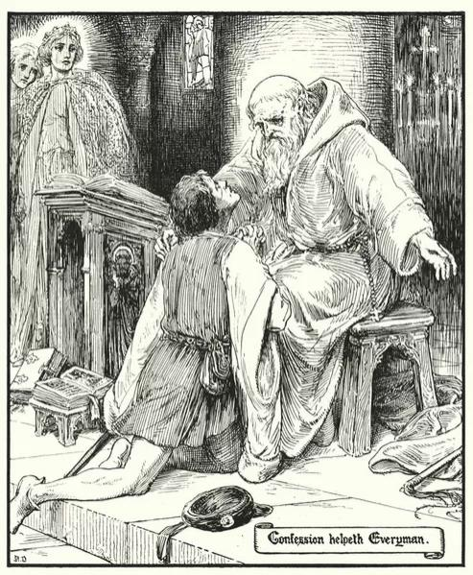

Slide 25
CONFESSION
CONFESSION:And a precious jewel I will give thee,
Called penance, wise voider of adversity;
Therewith shall your body chastised be,
With abstinence and perseverance in God’s service:
Here shall you receive that scourge of me,
Which is penance strong, that ye must endure,
To remember thy Saviour was scourged for thee
With sharp scourges, and suffered it patiently;
So must thou, or thou scape that that painful pilgrimage;
Knowledge, keep him in this voyage,
And by that time Good-Deeds will be with thee.
But in any wise, be sure of mercy,
For your time draweth fast, and ye will saved be;
Ask God mercy, and He will grant truly,
When with the scourge of penance man doth him bind,
The oil of forgiveness then shall he find.
Confession, with his spiritual wisdom, acknowledges Everyman’s sorrow, appreciates that he has come with Knowledge, and offers him a precious gift: penance. This penance, a holy sacrament, helps discipline the body and dedicate it to God’s service.
Confession warns Everyman of the suffering that comes with penance, comparing it to the "painful pilgrimage" that Jesus Christ endured for humanity’s salvation. He urges Everyman to persevere in penance to save his soul, assuring him that God’s forgiveness will heal him spiritually, like a heavenly ointment. Confession also predicts that Good-Deeds will join Everyman at the right time and asks Knowledge to remain by his side throughout the journey.

Slide 26
REPENTANCE
Me for to help at my ending,
And save me from the power of my enemy,
For Death assaileth me strongly,
And, Lady, that I may by means of thy prayer
Of your Son’s glory to be partaker,
By the means of h is passion I it crave,
I beseech you, help my soul to save.
Knowledge, give me the scourge of penance;
My flesh therewith shall give a quittance;
I will now begin, if God give me grace
EVERYMAN Because he would Everyman redeem,
Which Adam forfeited by his disobedience:
O blessed Godhead, elect and high-divine,
Forgive my grievous offence;
Here I cry thee mercy in this presence.
O ghostly treasure, O ransomer and redeemer
Of all the world, hope and conductor,
Mirror of joy, and founder of mercy,
Which illumineth heaven and earth thereby,
Hear my clamorous complain, though it late be;
Receive my prayers; unworthy in this heavy life,
Though I be, a sinner most abominable,
Yet let my name be written in Moses’ table;
O Mary, pray to the Maker of all thing
EVERYMAN: In the name of the Holy Trinity,
My body sore punished shall be:
Take this body for the sin of the flesh;
Also though delightest to go gay and fresh;
And in the way of damnation thou did me brine;
Therefore suffer now strokes and punishing.
Now of penance I will wade the water clear,
To save me from purgatory, that sharp fire.
GOOD-DEEDS: I thank God, now I can walk and go;
And am delivered of my sickness and woe.
Therefore with Everyman I will go, and not spare;
His good works I will help him to declare.

Slide 27
Everyman, realizing his need for salvation, expresses gratitude to God for the wisdom granted to him. He resolves to undergo purification and face the challenges of penance with determination. Knowledge assists him by offering spiritual guidance, helping him endure the physical and mental pains of the process, and preparing his record for judgment.
Everyman prays earnestly to God, confessing his sins and acknowledging humanity's fall through Adam. He begs for forgiveness and pleads with God to inscribe his name in Moses' table. He also appeals to the Virgin Mary to intercede on his behalf, seeking her comfort at the end of his life and protection from the Devil.
Embracing spiritual transformation, Everyman seeks divine grace and accepts physical suffering through penance to atone for his past sins. With Knowledge's support and his renewed focus on spiritual redemption, he dedicates himself to purifying his soul in preparation for God’s final judgment.

Slide 28
EVERYMAN MEETS DISCRETION, BEAUTY, STRENGTH, FIVE WITS
GOOD-DEEDS: Yet must thou lead with thee
Three persons of great might.
EVERYMAN: Who should they be?
GOOD-DEEDS: Discretion and Strength, they hight,
And thy Beauty may not abide behind
STRENGTH: We will bring him all thither,
To his help and comfort, ye may believe me.
DISCRETION: So will we go with him all together.
EVERYMAN: Almighty God, loved thou be,
I give thee laud that I have hither brought
Strength, Discretion, Beauty, and Five-wits; lack I nought;
And my Good-Deeds, with Knowledge clear,
I desire no more to my business.
KNOWLEDGE: Also ye must call to mind.
Your Five-wits as for your counsellors.
GOOD-DEEDS: You must have them ready at all hours.
EVERYMAN: How shall I get them hinder?
KNOWLEDGE: You must call them all together,
And they will hear you counsel.
EVERYMAN: My friends, come hither and be present
Discretion, Strength, my Five-wits and Beauty.
BEAUTY: Here at you will we be all ready.
What will ye that we should do?
GOOD-DEEDS: That ye would with Everyman go,
And help him in his pilgrimage,
Advise you, will ye with him or not in that voyage?
DISCRETION: Everyman, advise you first of all;
Go with a good advisement and deliberation;
We all give you virtuous counsel,
That all shall be well.

Slide 29
Everyman, guided by Knowledge, gathers additional companions—Discretion, Strength, Beauty, and Five-Wits—to assist him on his spiritual journey. Beauty is the first to offer her support, and the group agrees to help him complete his pilgrimage. Good-Deeds reminds them of the importance of their commitment.
Strength assures Everyman of physical support, Discretion offers guidance, and Five-Wits advises him to avoid being misled by sensory temptations. Everyman expresses his gratitude for their presence, feeling complete with their companionship. However, Beauty soon departs, demonstrating the fleeting nature of physical attributes, while Discretion and Strength promise to remain steadfast.
Everyman declares that he no longer desires worldly possessions and prays for blessings upon his companions. He prepares his testament, dedicating half of his wealth to charity and returning the rest to its rightful place, symbolically resisting the influence of Satan as he continues his spiritual preparation.

Slide 30
FORSAKE
BEAUTY: What into this grave? Alas!
EVERYMAN: Yea, there shall you consume more and less.
BEAUTY: And what, should I smother here?
EVERYMAN: Yea, by my faith, and never more appear.
In this world live no more we shall,
But in heaven before the highest Lord of all.
BEAUTY: I cross out all this; adieu by Saint John;
I take my cap in my lap and am gone.
EVERYMAN: What, Beauty, whither will ye?
BEAUTY: Peace, I am deaf; I look not behind me,
Not and thou would give me all the gold in thy chest.
DISCRETION: Everyman, I will after Strength be gone,
As for me I will leave you alone.
EVERYMAN: Why, Discretion, will ye forsake me?
DISCRETION: Yea, in faith, I will go from thee,
For when Strength goeth before
I follow after evermore.
EVERYMAN: Yet, I pray thee, for the love of the Trinity,
Look in my grave once piteously.
DISCRETION: Nay, so nigh will I not come.
Farewell, every one!
EVERYMAN: O all thing faileth, save God alone;
Beauty, Strength, and Discretion;
For when Death bloweth his blast,
They all run from me full fast.
FIVE-WITS: Everyman, my leave now of thee I take;
I will follow the other, for here I thee forsake.
EVERYMAN: O Jesu, help, all hath forsaken me!
EVERYMAN: Alas, whereto may I trust?
Beauty goeth fast away hie;
She promised with me to live and die.

Slide 31
Everyman prays to Jesus for help and thanks his companions for their guidance and support. Ready to proceed, he urges them to follow God Almighty. Initially, Strength, Discretion, and Knowledge pledge to stay with him, but Everyman begins to weaken and reflects on the inevitability of death and the grave.
When Beauty learns that she will be buried in the grave, she abandons Everyman, showing her fleeting nature. Strength also leaves, refusing to stay even as Everyman pleads with her. Discretion departs soon after, ignoring Everyman’s pleas. Lastly, Five-Wits leaves, unwilling to stay without the others.
Left with only Good-Deeds and Knowledge, Everyman realizes the impermanence of worldly attributes and decides not to depend on them, understanding that only spiritual virtues endure in the face of death.

Slide 32
EVERYMAN: O Jesu, help, all hath forsaken me!
GOOD-DEEDS: Nay, Everyman, I will bide with thee,
I will not forsake thee indeed;
Thou shalt find me a good friend at need.
EVERYMAN: Gramercy, Good-Deeds; now may I true friends see;
They have forsaken me every one;
I loved them better than my Good-Deeds alone.
Knowledge, will ye forsake me also?
KNOWLEDGE: Yea, Everyman, when ye to death do go;
SALVATION OF EVERYMAN
EVERYMAN: Gramercy, Knowledge, with all me heart.
KNOWLEDGE: Nay, yet I will not from hence depart,
Till I see where ye shall become.
EVERYMAN: Methinketh, alas, that I must be gone,
To make my reckoning and my debts pay,
For I see my time is nigh spent away.
Take example, all ye that do hear or see,
How they that I loved best do forsake me,
Except my Good-Deeds that bideth truly.
GOOD-DEEDS: All earthly things is but vanity:
Beauty, Strength, and Discretion, do man forsake,
Foolish friends and kinsmen, that fair spake,
All fleeth save Good-Deeds, and that am I.
EVERYMAN: Have mercy on me, God, most mighty;
And stand by me, thou Mother and Maid, holy Mary

Slide 33
EVERYMAN: Into thy hands, Lord, my soul I commend;
Receive it, Lord, that it be not lost;
As thou me boughtest, so me defend,
And save me from the fiend’s boast,
That I may appear with that blessed host
That shall be saved at the day of doom.
In manus tuas- of might’s most
For ever- commendo spiritum meum.
KNOWLEDGE: Now hath he suffered that we all shall endure;
The Good-Deeds shall make all sure.
Now hath he made ending;
Methinketh that I hear angels sing
And make great joy and melody,
Where Everyman’s soul received shall be.
ANGEL: Come, excellent elect spouse to Jesu:
Hereabove thou shalt go
Because of thy singular virtue:
Now the soul is taken the body fro;
Thy reckoning is crystal-clear.
Now shalt thou into the heavenly sphere,
Unto the which all ye shall come
That liveth well before the day of doom.

Slide 34
Ultimately, Good-Deeds becomes the sole companion of Everyman. Good-Deeds
inspires Everyman, assuring him of her support, “Thou shalt find me a good friend
at need.” Everyman admits that he loved Beauty, Strength, Discretion, and Five-Wits
more than Good-Deeds but now he has only her to depend on.
Good-Deeds illustrates in one statement the vanity of all earthly things; the fickleness
of qualities such as Beauty, Strength, and Discretion; the foolishness of Fellowship
and Kindred whose cajoling is meaningless; and the dependable nature of Good-
Deeds.
Fortified by Good-Deeds, Everyman entrusts himself to God, appealing to the Holy Spirit for protection from the Devil until the final judgment when his good deeds will defend him. Knowledge, though remaining loyal, acknowledges her inability to help further as death nears and leaves Everyman to the care of Good-Deeds.
Knowledge encourages the audience to imagine the joyful reception awaiting Everyman in Heaven, marked by angelic songs and celebration. An Angel escorts Everyman to Heaven, praising his virtues and affirming his positive judgment. The Angel urges everyone to follow Everyman’s example for their own salvation.

